Slide 1
Served with Microplastics
Uncovering the Hidden Contaminants on Our Plates
TechLabs Düsseldorf
Summer Term 2025 Data Science Track – Group 2
Notes:
Who are we? Negin, Nicole, Hamam, Gaetano A group with different backgrounds in statistics, computer science, linguistics N. B.: This is just a provisional name for the project, we can change it anytime. I just needed a placeholder. !!! The presentation should last around max. 7 minutes !!!

Slide 2
Today’s Agenda
Idea and Project Outline
Problems & Solutions
Learnings
Streamlit Demo

Slide 3

Idea & Project Outline
Initial Planning
Project Goals
Global non-profit dedicated to food safety and advocacy
Mission: raise awareness on emerging contaminants in diets
Focus on microplastics and their impact on human health
Analyze global dataset on estimated microplastic consumption
Pinpoint high-risk food categories
Identify trends over time and geographical variations
Translate findings into public health campaigns & policy guidance

Slide 4
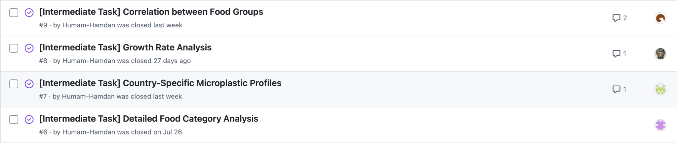
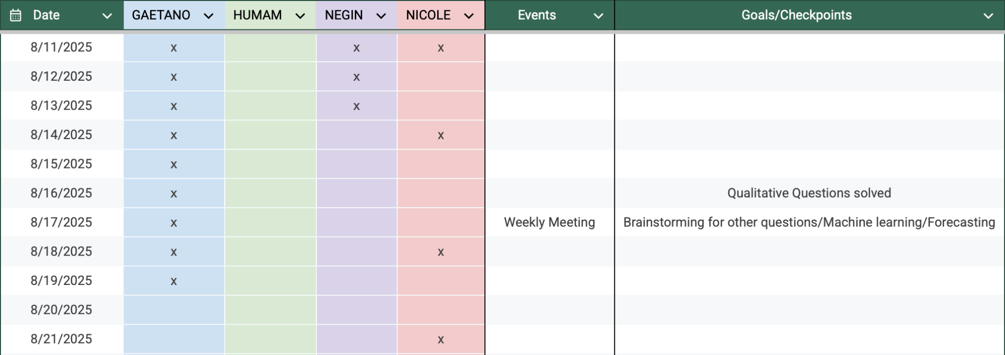
Idea & Project Outline
Our initial planning…
…vs how it actually went
Group events, deadlines as well as work capabilities were documented
We created forks for each contributor
The questions of the INSTRUCTIONS.md were translated issues and assigned
We kept it flexible: if deadlines couldn’t be met as planned, we discussed possible solutions
Questions suggested from the mentors were used as a baseline
After getting the first interesting results, we expanded our analysis with our personal ideas
Notes:
We spent one week each on our beginner questions, and two weeks each on our intermediate questions

Slide 5


Problems & Solutions
Packages & Frameworks
Version control
Communication

Slide 6
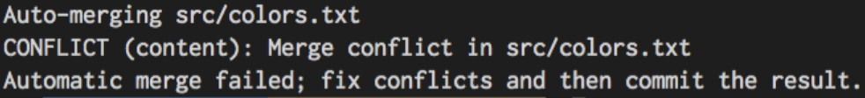
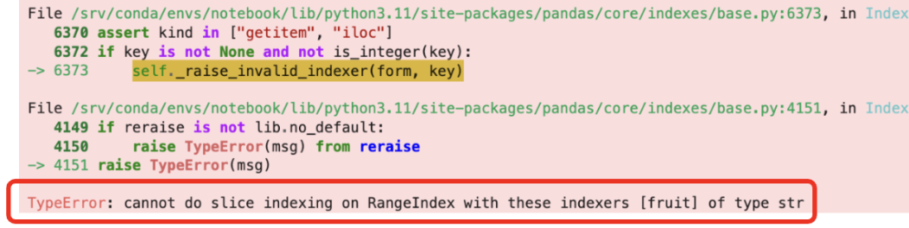
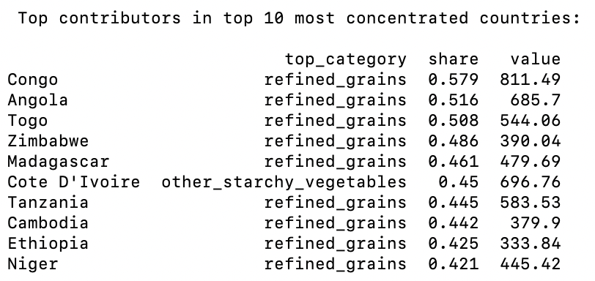
Problems & Solutions
Of course, this project didn’t come without challenges!
Navigating version control 💥
Deciphering pandas errors 🐼
Making a storyline out of our data 📊
Notes:
How we overcame these challenges: open communication, mentor’s help, help of ChatGPT

Slide 7

Learnings
What did we learn?
But more importantly…
Using pandas for grouping, filtering, and aggregations
Creating different visualizations (line plots, stacked area, bar plots)
Applying metrics like CAGR, rank shifts, and concentration measures
Version control with Git/GitHub, resolving merge conflicts
Streamlit for turning analysis into an interactive app
How to divide tasks in a data science team
Importance of clear communication at every step
Documenting steps so teammates can follow
Not panicking when merge conflicts show up!

Slide 8
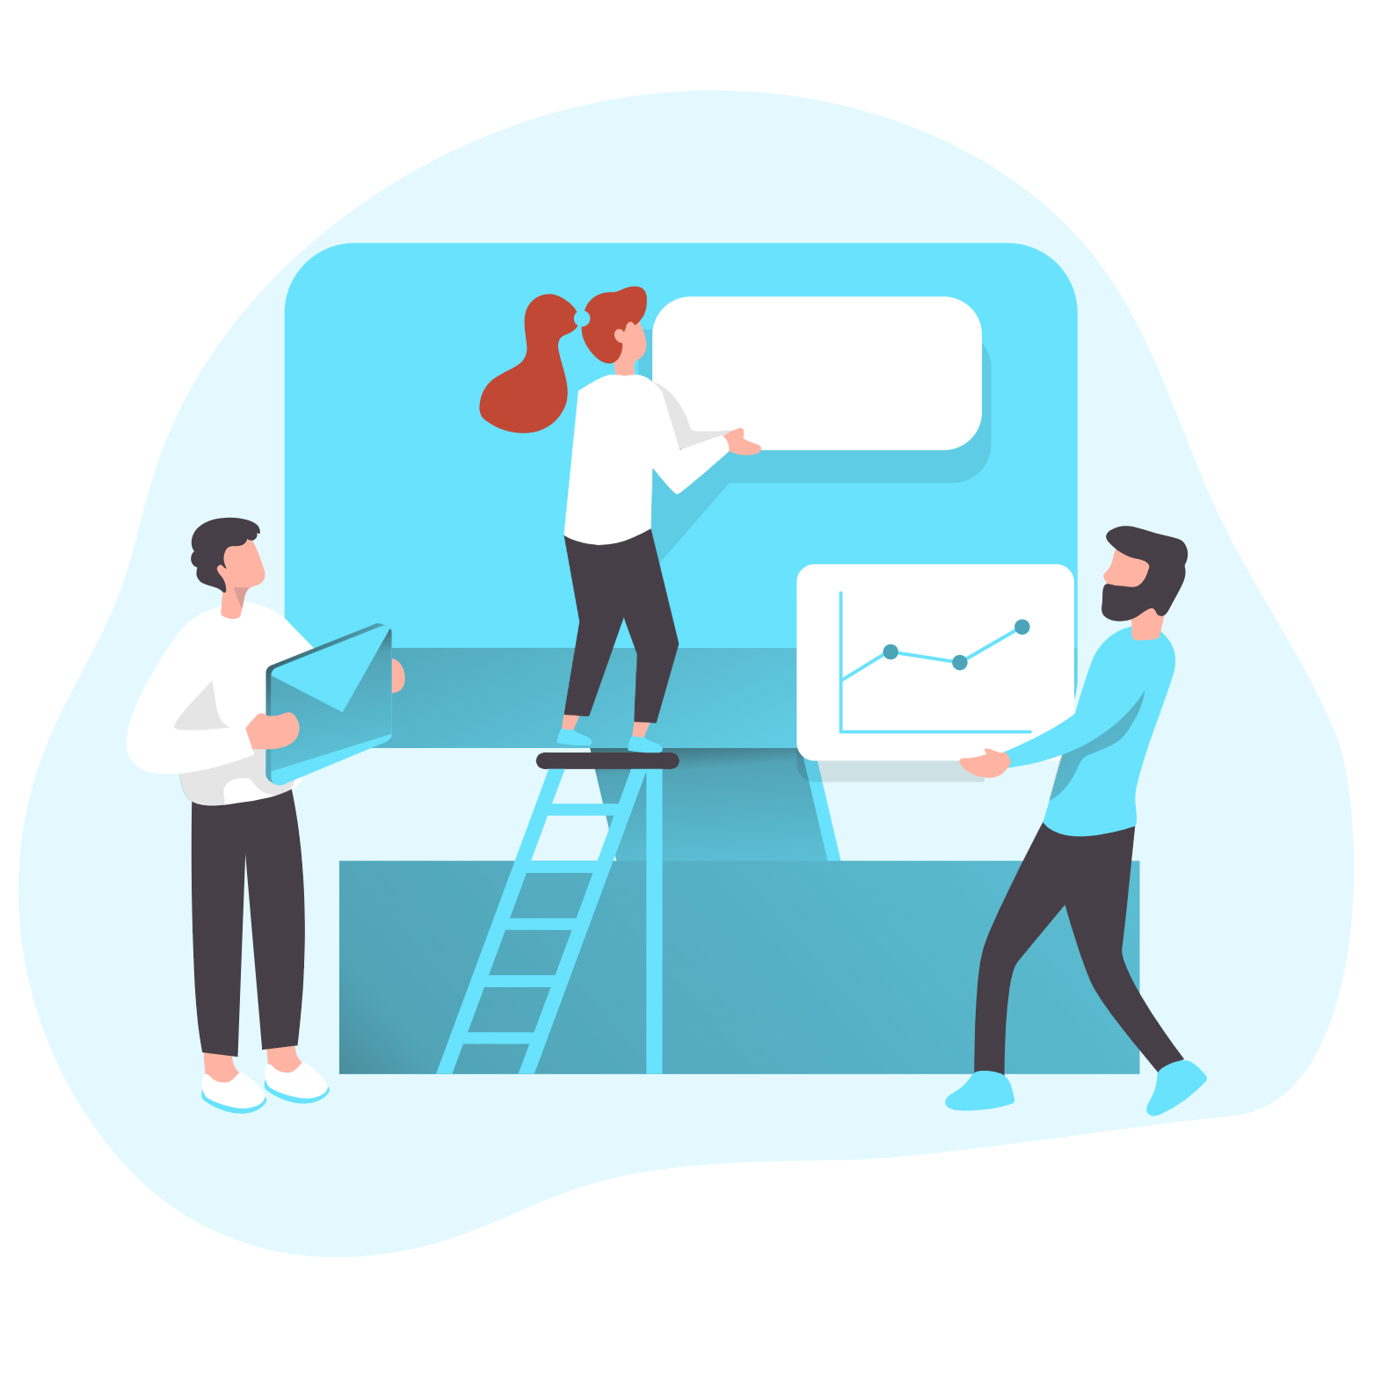
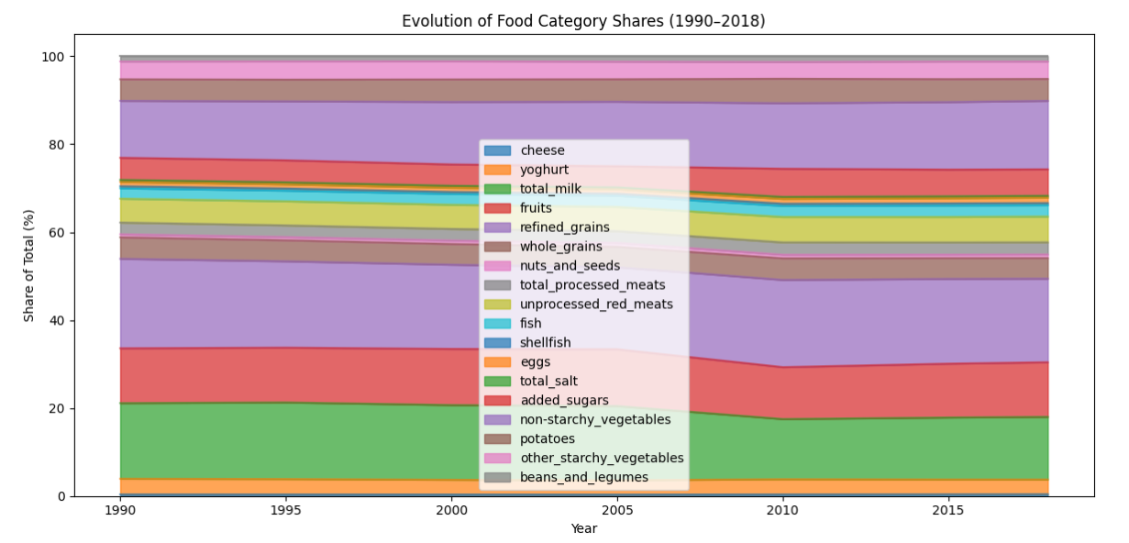

Learnings
The Project Phase
Next time we will…
Challenging but very practical:
not just coding, but also collaborating like in a “real” data science team
Fun to discover unexpected patterns
(like contamination being very stable across decades)
Plan visualizations earlier, so the storyline emerges sooner.

Slide 9
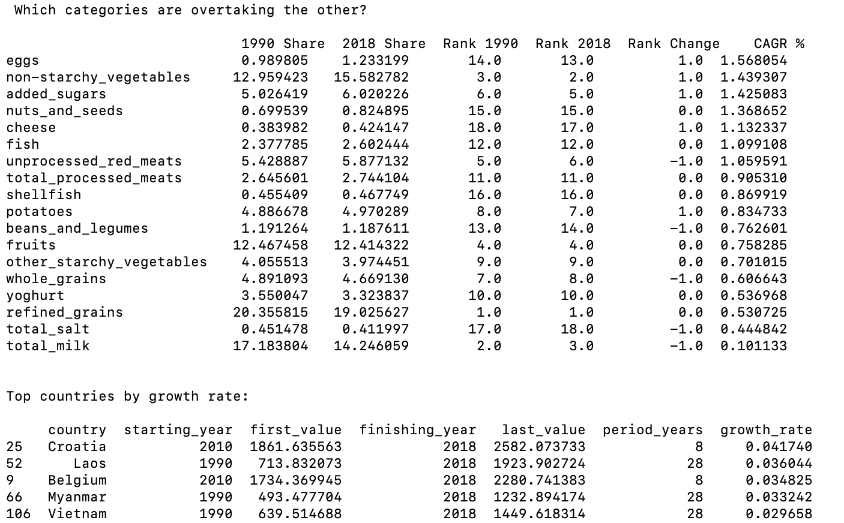
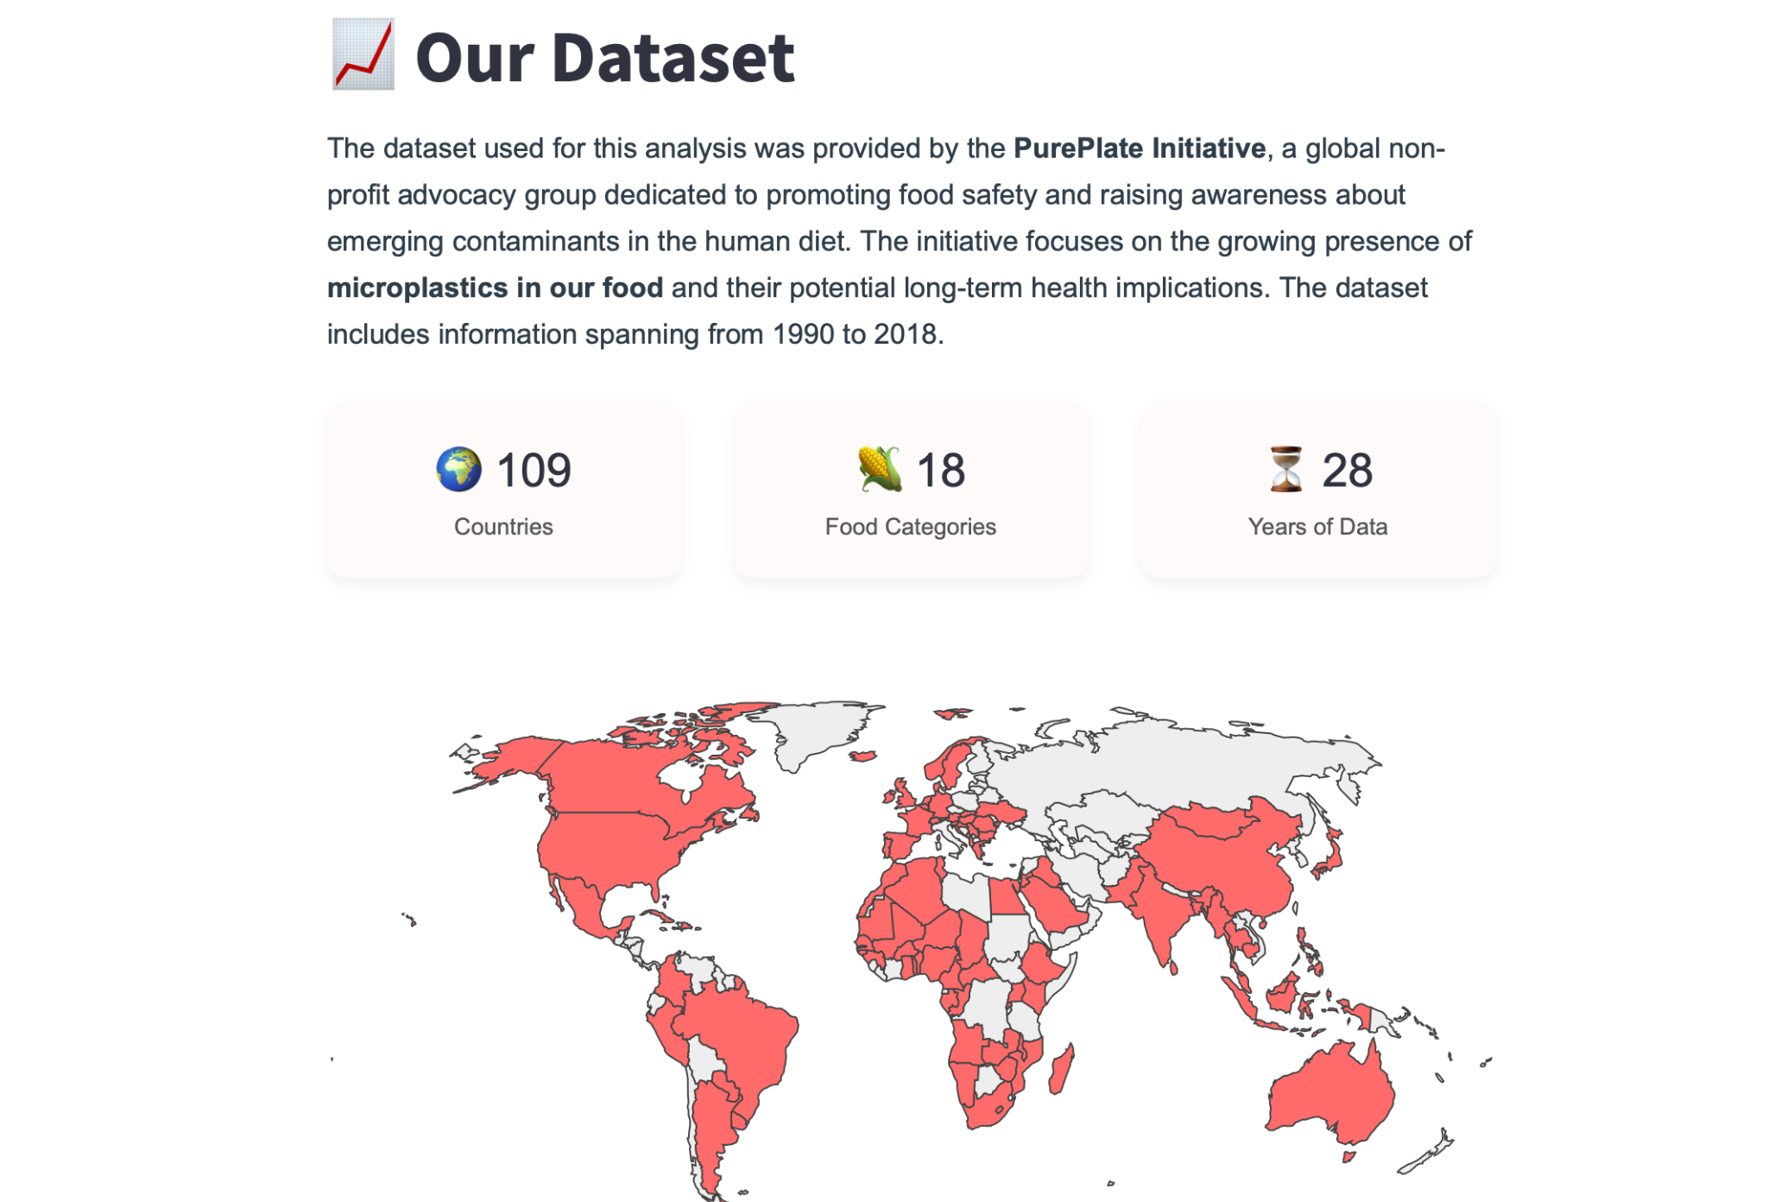
Streamlit Demo
Originally… Analysis stored in main.py (prints & calculations) However, results were difficult to interpret visually
So…
We built a Streamlit web app for clear, interactive insights
Notes:
Here, we can introduce the Streamlit web app and why we created it (s. slide text)
After introducing the topic, we can open the web app and go through it briefly

Slide 10
PurePlate Initiative Group 3
Humam Hamdan
Gaetano Manzone
Negin Doostdar
Nicole Mikula

